Slide 1
Image recognition
Part 3: Evaluating our algorithm

Slide 2
Learning outcomes
I know that an algorithm is a set of instructions that solves a problem.
I know that bias is when a dataset is incomplete or inaccurate in a way that means it doesn’t accurately represent the whole picture.
I can describe some of the limitations of AI image recognition.

Slide 3
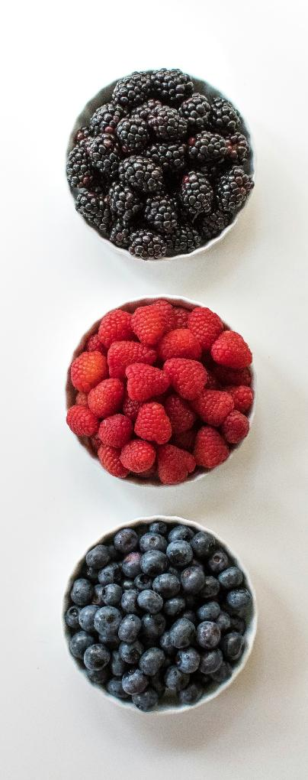
Key words
bias
When a dataset is incomplete or inaccurate in a way that means it doesn’t accurately represent the whole picture.
Example
I want to learn about berries, so I made a dataset by getting all the fruit with ‘berry’ in the name from the shop.
The dataset is biased because it does not accurately represent all types of berries*.
Photo by Davies Designs Studio on Unsplash
Notes:
*Botanists (scientists who study plants) would say that in the photo, only blueberries are technically berries.
Bias is also used in common speech and other subjects, including PSHE, History, and English, where it usually refers to a feeling or opinion that influences how someone reacts to a situation or person.
Examples
A person’s favourite colour is green. This might influence them to choose green clothing to wear. This person has a bias towards the colour green.
Someone doesn’t like the taste of bananas. This dislike might influence them to not choose to cook recipes that use bananas as an ingredient. This person has a bias against bananas.

Slide 4
How does what we have done compare with AI?

Slide 5
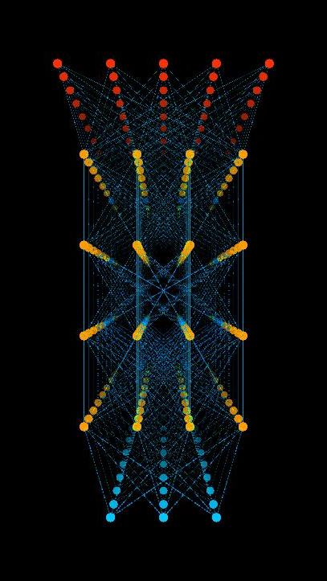
How does this compare with AI?
Computer image recognition works in a similar way to what we have done, but with algorithms that contain many more steps.
For example, the computer needs steps for:
  what counts as red
  what part of the image is the head or thorax
  how to tell what is a leg or an antenna

Slide 6
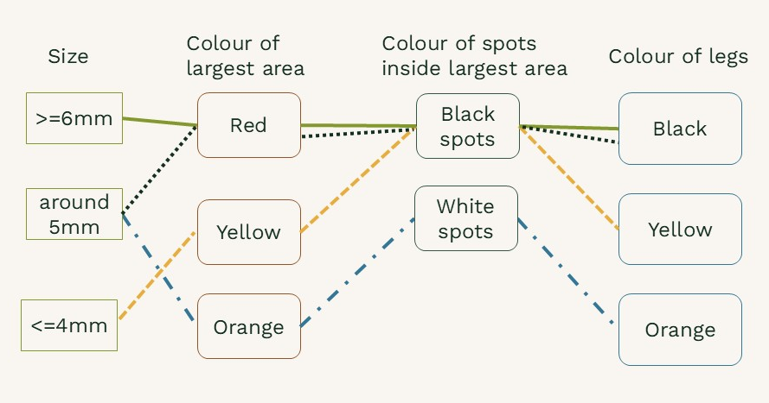
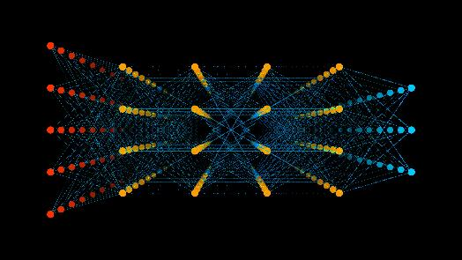
AI
Nodes in our image recognition algorithm
AI models can have millions or billions of nodes that act like the questions in the keys we made.
AI algorithms are programmed so that when given training data the programming fills in the nodes and connections automatically.
This process of a programme learning on its own is also called machine learning.
Illustration of nodes in an AI algorithm

Slide 7
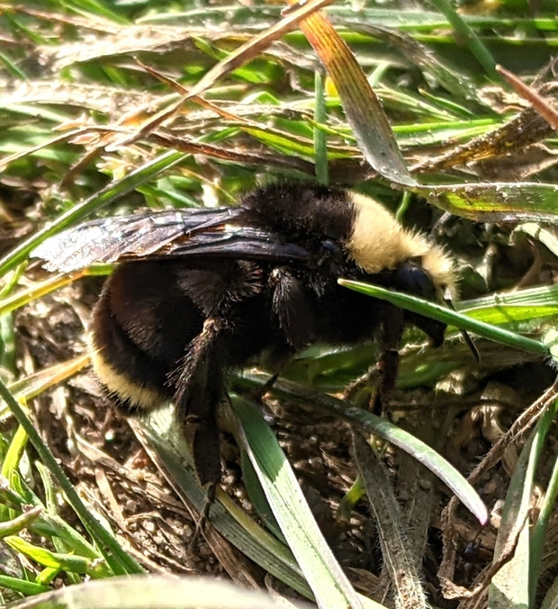
Limitations of AI
Let’s try to use our bumblebee identification algorithm to identify this bumblebee.
This is one of the yellow-faced bumblebees found in North America.
Why didn’t we get this answer?
iNaturalist observation 110154179. CC0

Slide 8
Our training data was limited
We trained our algorithm only on images of species found in the United Kingdom. This means it can only give responses of UK species, if it works at all.
This is an example of how bias in the training data can affect AI results.
In data science, bias is when a dataset is incomplete or inaccurate in a way that means it doesn’t accurately represent the whole picture.

Slide 9
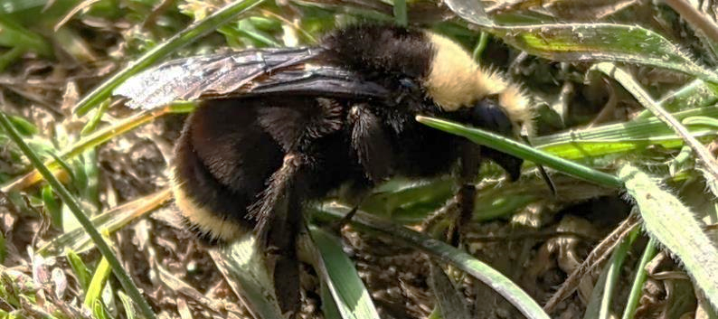
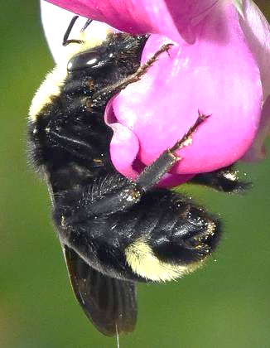
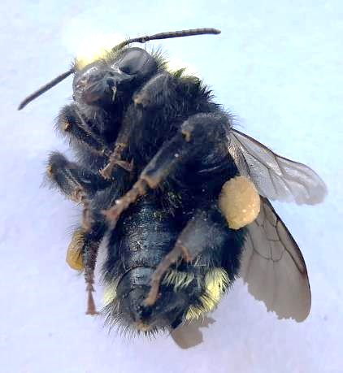
Limitations of photos
Unknown Bumblebee
There are two very similar species found in the area where this photo was taken. The two species can be differentiated by the colour of the hairs on the underside of the abdomen, but we can’t see it in the photo.
Some species cannot be identified from normal photos. Scientists need to look at the animal’s insides, use a microscope, or analyse the animal’s DNA.
iNaturalist observation 110154179. CC0
Yellow-faced Bumble Bee Bombus vosnesenskii
Fog-belt Bumble Bee
Bombus caliginosus
No yellow hairs
Yellow hairs
iNaturalist observation 299507532 by user Marcel_Pepin. CC by 4.0
iNaturalist observation 163413013 by user LJ Moore-McClelland. CC by 4.0

Slide 10
Thinking about our algorithm
How many ways can we find to make our algorithm give us the wrong answer?
How can we fix our algorithm so these problems don’t happen?
For example:
Does our algorithm work when the photo is of the underside of a bumblebee?
We could remove this problem by adding a question that asks if we are looking at the upper side or under side of the bumblebee.
Notes:
It might not be possible to fix an algorithm so that it still gives a correct answer. In these cases, an algorithm will need to have a result like – cannot be identified.
A few other possible responses:
Use a photo of a bumblebeebee not found in the UK. – Ask for the location where the photo was taken.
Use a photo where the bumblebee’s head is in a flower. – Ask if the whole bee is visible in the photo.
Use a blurry photo.
Use a photo that is very dark or very light.

Slide 11
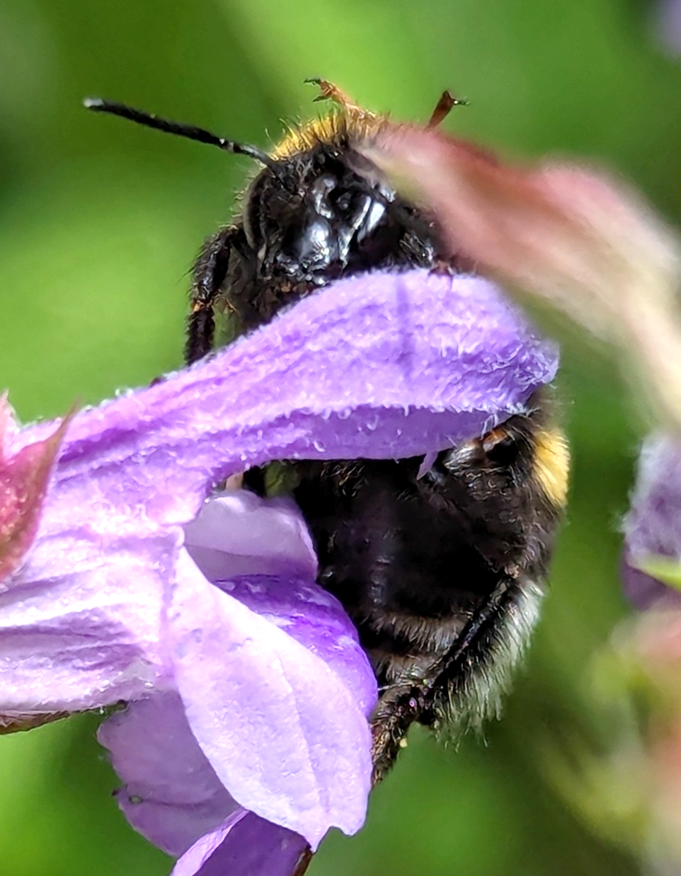
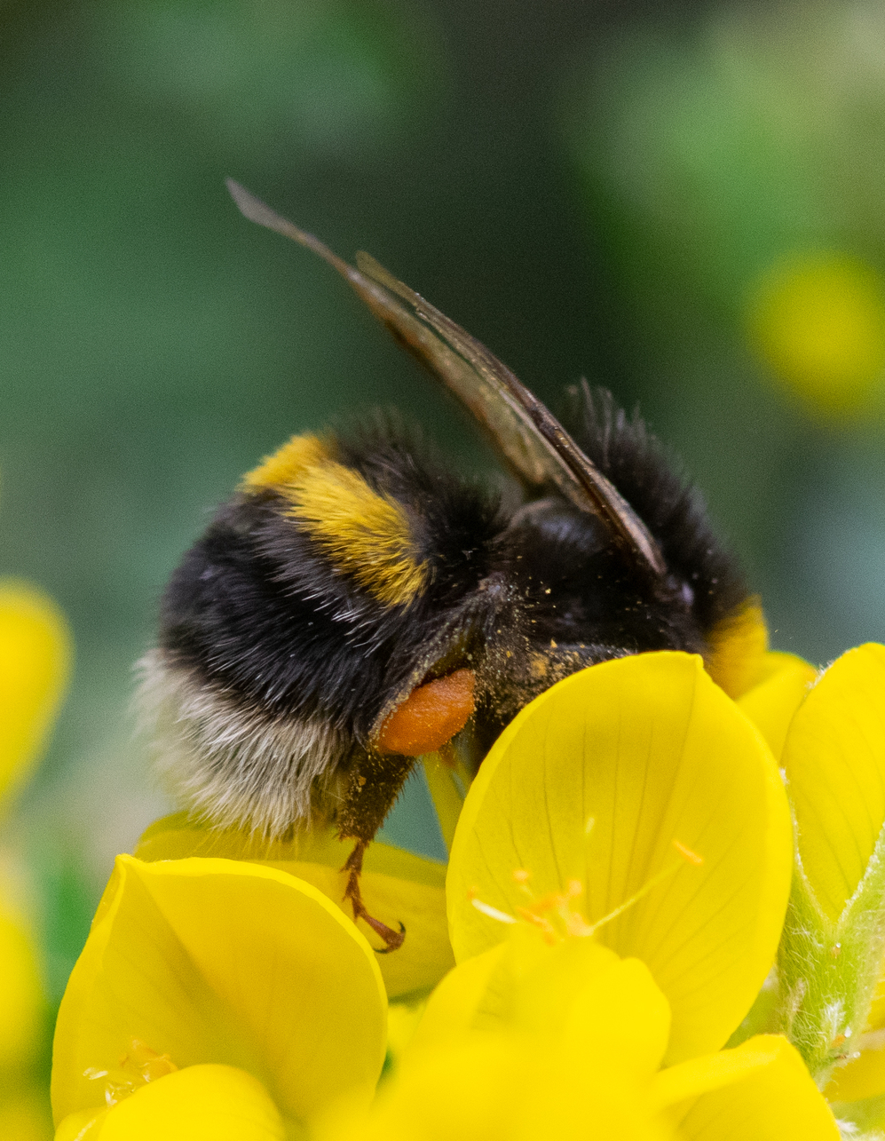
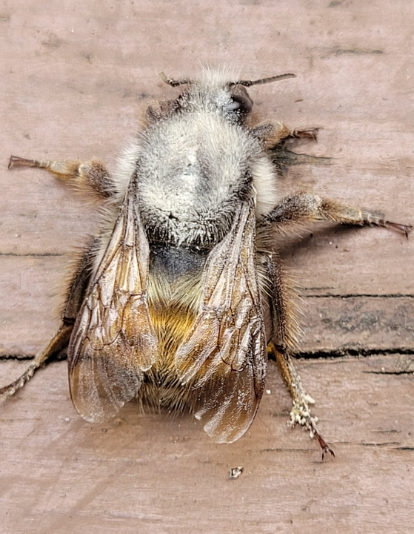
Example photos that might not work in our algorithms
Buff-tailed bumblebee
Photo taken in France
Buff-tailed bumblebee
Photo taken in UK
Yellow-fronted bumblebee
Photo taken in Canada
iNaturalist observation 216347668. CC0 1.0
iNaturalist observation 157332166. CC0 1.0
iNaturalist observation 286890450. CC0 1.0

Slide 12
AI limitations
AI image recognition models have the same limitations.
  They can have biases from their training data.
  Image recognition models cannot reliably identify things from images that don’t have the necessary information.
  They cannot reliably identify things which cannot be identified visually. Some species can only be identified from microscopic inspection or by analysing their DNA.

Slide 13
Reflection questions
What might be some situations where AI image recognition might be misleading or not helpful?
What might be some situations where AI image recognition would be a helpful tool to use?
Notes:
Responses here could include discussion about:
limitations of visual information
bias in training data
speed of computer processing
bias and subjectivity in humans
1.
Situations where there isn’t good training data. For example, many small insects are not well studied, so there isn’t good data (photos of animals with confirmed identifications) to train an AI model on.
Situations where visual information is not enough. For example, some species can only be differentiated using DNA. Another example is food, you can’t always tell if a dish tastes good just by looking at it.
Tasks which involve value judgements or opinions. For example, judging the quality of a piece of art. Different people have different artistic tastes.
2.
Sorting through large amounts of data.
Sorting things in a way that removes human subjectivity. For example, optical illusions. The way humans’ eyes and brains work can trick us into seeing or thinking things that aren’t really.
Identifying differences that humans might miss. For example, humans might overlook small details in an image. This is especially true when humans do repetitive tasks. Computers don’t get tired in the same way.

